Slide 1
Lecture 4 – Gradient Descent (Theoretical Foundation)

Slide 2

Model representation
Linear regression with one variable
Machine Learning

Slide 3
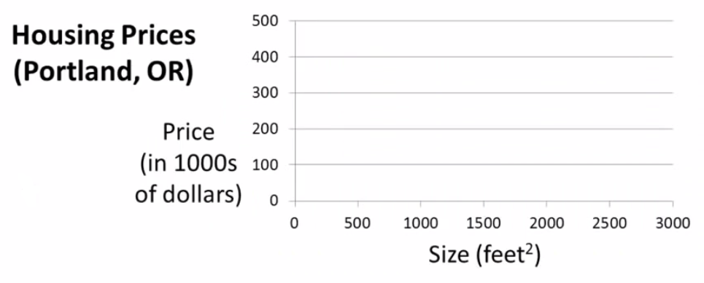


Slide 4
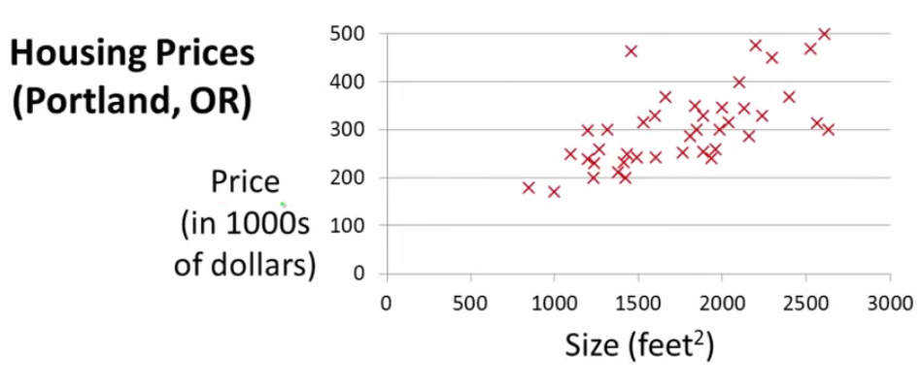

Slide 5
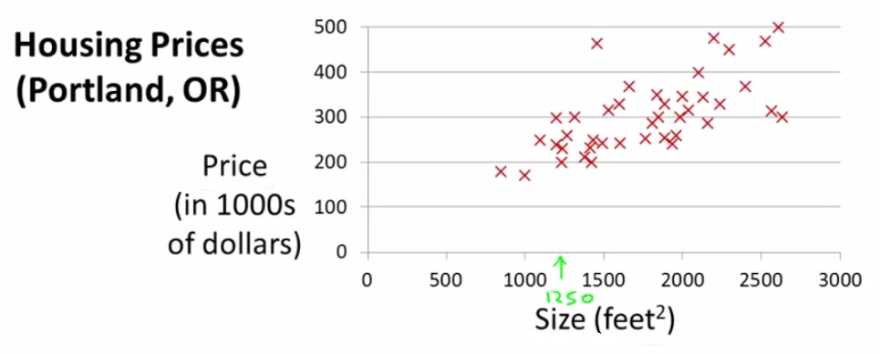

Slide 6
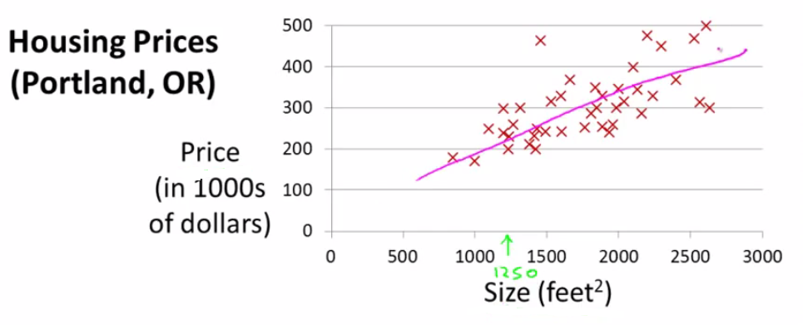

Slide 7
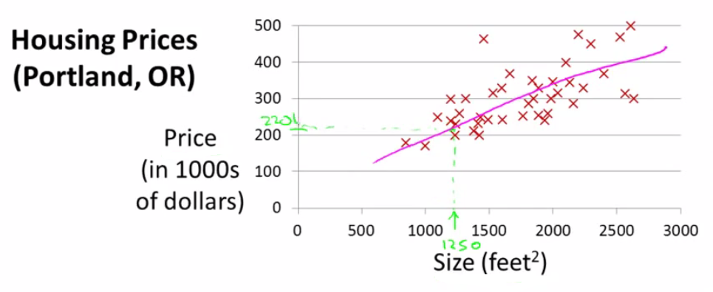

Slide 8
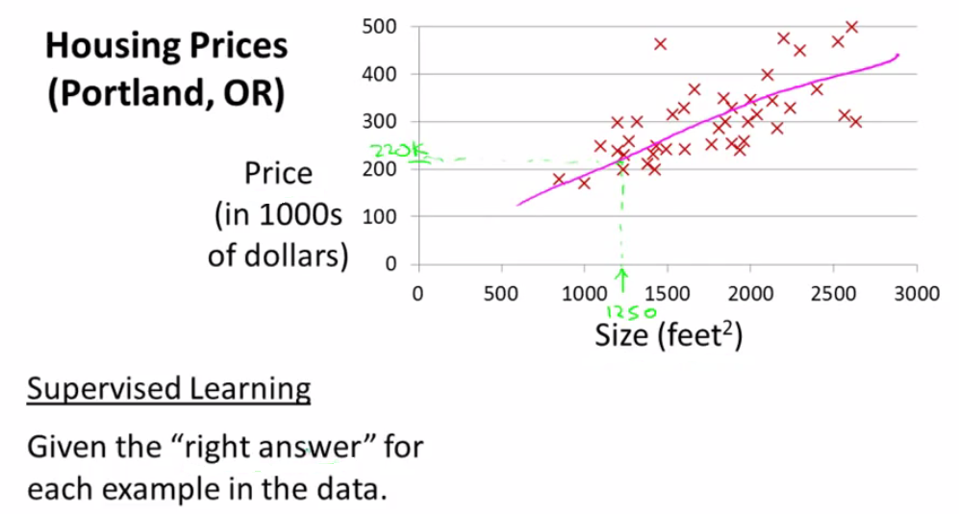

Slide 9
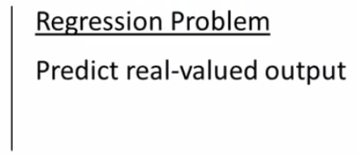

Slide 10
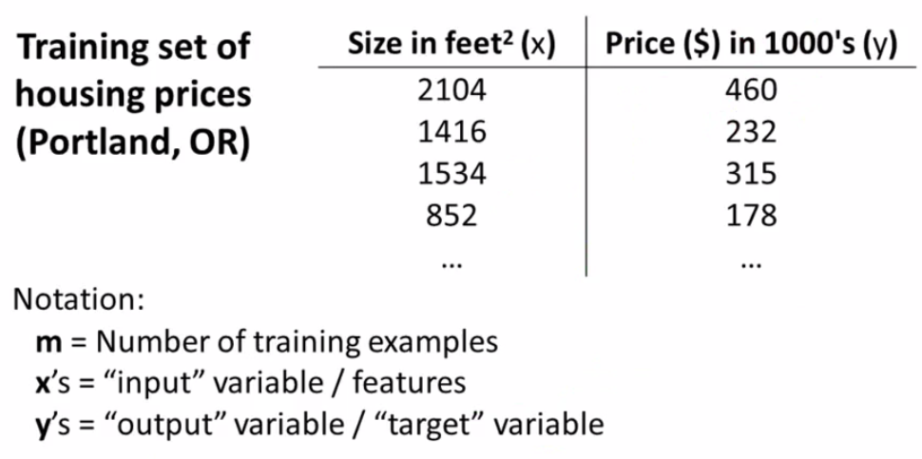

Slide 11

(x, y)= One Training Example
x (i), y (i)= ith Training example
x (1) = 2104
x (2) = 1416
y (1) = 460
Y (2) = 232

Slide 12

Training Set
How do we represent h ?
Learning Algorithm
Size of house
h
Estimated price
Linear regression with one variable.
Univariate linear regression.

Slide 13
That formula might look scary, but if you think about it it's nothing fancier than the traditional equation of a line, except that we use θ0 and θ1 instead of m and q. Do you remember?
f(x)=q+mx
In our humble hypothesis function there is only one variable, that is x. For this reason our task is often called linear regression with one variable. Experts call it also univariate linear regression, where univariate means "one variable".

Slide 14
Cost function
Linear regression with one variable
Machine Learning

Slide 15
A cost function lets us figure out how to fit the best straight line to our data.

Slide 16
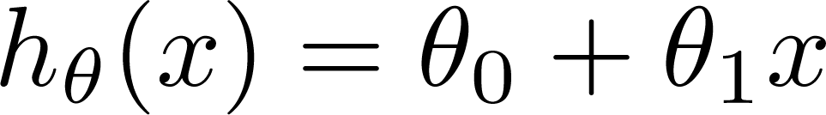

Training Set
Size in feet² (x) | Price ($) in 1000's (y)
2104 | 460
1416 | 232
1534 | 315
852 | 178
… | …
Hypothesis:
‘s: Parameters
How to choose ‘s ?

Slide 17
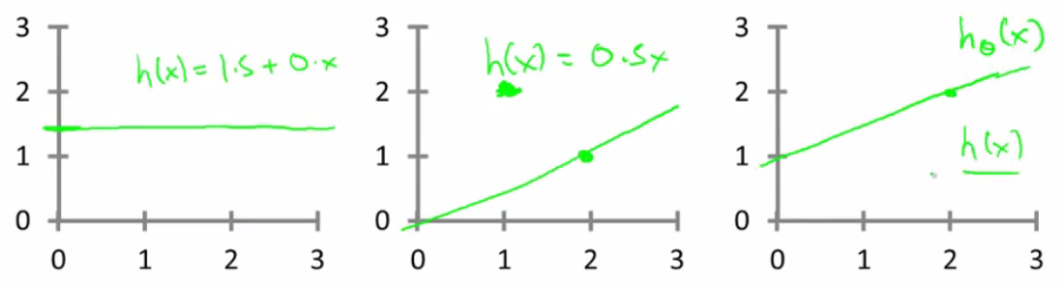
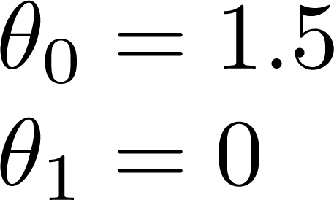
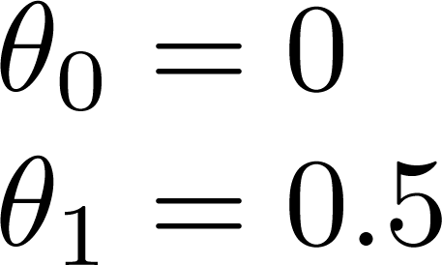
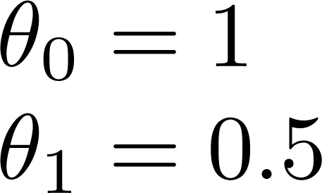

Slide 18
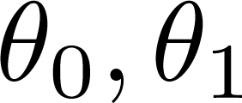


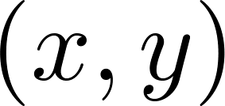
y
x
Idea: Choose so that is close to for our training examples

Slide 19
Based on our training set we want to generate parameters which make the straight line
Chosen these parameters so h_{θ}(x) is close to y for our training examples
Basically, uses xs in training set with h_{θ}(x) to give output which is as close to the actual y value as possible
Think of h_{θ}(x) as a "y imitator" - it tries to convert the x into y, and considering we already have y we can evaluate how well h_{θ}(x) does this

Slide 20
To formalize this;
We want to want to solve a minimization problem
Minimize (h_{θ}(x) - y)²
i.e. minimize the difference between h(x) and y for each/any/every example
Sum this over the training set

Slide 21

Minimize squared different between predicted house price and actual house price1/2m
1/m - means we determine the average
1/2m the 2 makes the math a bit easier, and doesn't change the constants we determine at all (i.e. half the smallest value is still the smallest value!)

Slide 22

Minimizing θ₀/θ₁ means we get the values of θ₀ and θ₁ which find on average the minimal deviation of x from y when we use those parameters in our hypothesis function
More cleanly, this is a cost function

Slide 23
So to recap
Hypothesis - is like your prediction machine, throw in an x value, get a putative y value.
Cost - is a way to, using your training data, determine values for your θ values which make the hypothesis as accurate as possible
This cost function is also called the squared error cost function.
This cost function is reasonable choice for most regression functions.
Probably most commonly used function.
In case J(θ₀,θ₁) is a bit abstract, going into what it does, why it works and how we use it.

Slide 24
Cost function intuition I
Linear regression with one variable
Machine Learning

Slide 25
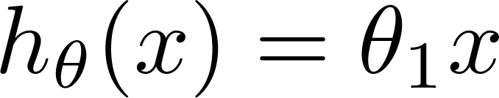

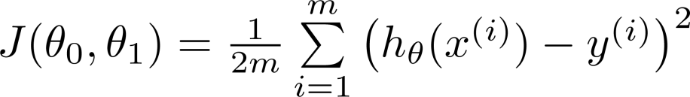
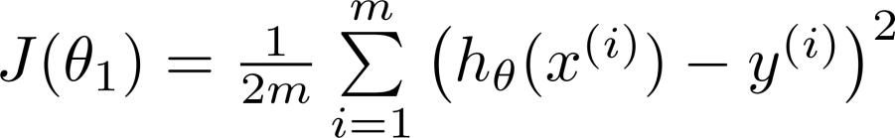
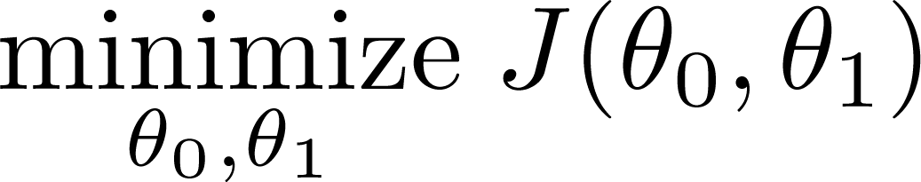
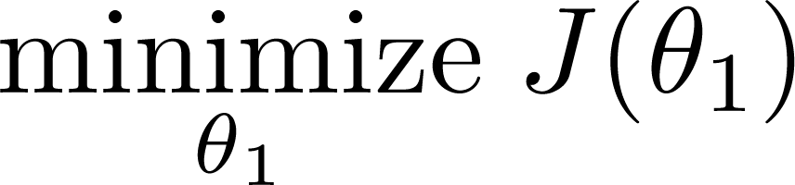
Simplified
Hypothesis:
Parameters:
Cost Function:
Goal:

Slide 26
Lets consider some intuition about the cost function and why we want to use it
The cost function determines parameters
The value associated with the parameters determines how your hypothesis behaves, with different values generate different
Simplified hypothesis
Assumes θ₀ = 0

Slide 27
Cost function and goal here are very similar to when we have θ₀, but with a simpler parameter
Simplified hypothesis makes visualizing cost function J() a bit easier

Slide 28






(for fixed , this is a function of x)
(function of the parameter )
y
x
So for example
θ₁ = 1
J(θ₁) = 0
θ₁ = 0.5
J(θ₁) = ~0.58
θ₁ = 0
J(θ₁) = ~2.3

Slide 29

(for fixed , this is a function of x)
(function of the parameter )
y
x

Slide 30
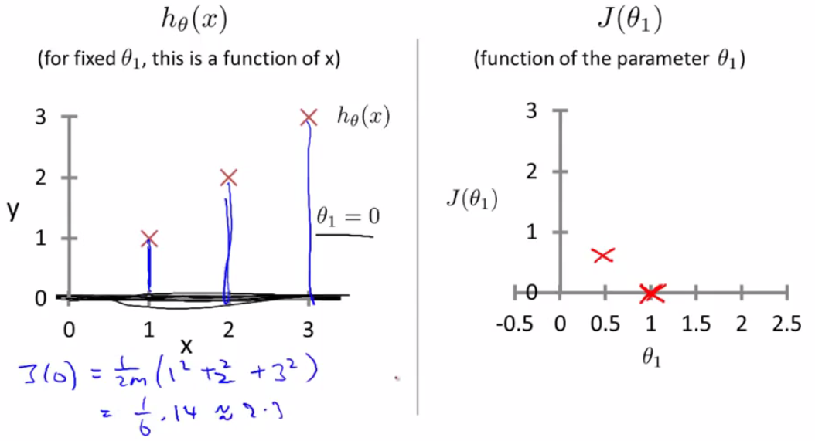

Slide 31
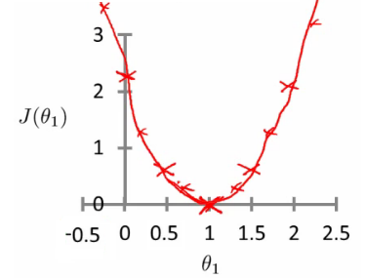
If we compute a range of values plot
J(θ₁) vs θ₁ we get a polynomial (looks like a quadratic)
The optimization objective for the learning algorithm is find the value of θ₁ which minimizes J(θ₁)
So, here θ₁ = 1 is the best value for θ₁

Slide 32
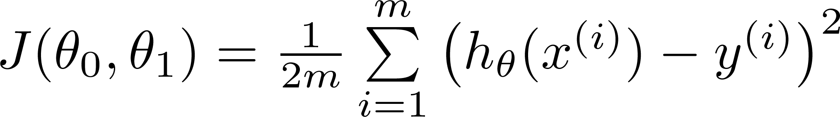
Hypothesis:
Parameters:
Cost Function:
Goal:

Slide 33
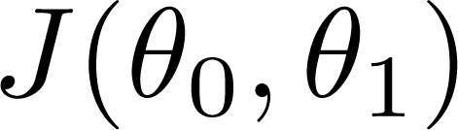


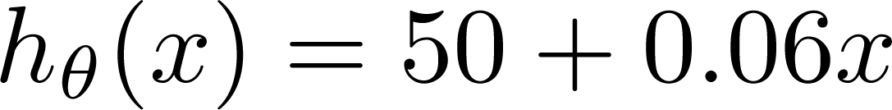
(for fixed , this is a function of x)
(function of the parameters )
Price ($)
in 1000’s
Size in feet² (x)

Slide 34
Previously we plotted our cost function by plotting
θ₁ vs J(θ₁)
Now we have two parameters
Plot becomes a bit more complicated
Generates a 3D surface plot where axis are
X = θ₁
Z = θ₀
Y = J(θ₀,θ₁)

Slide 35
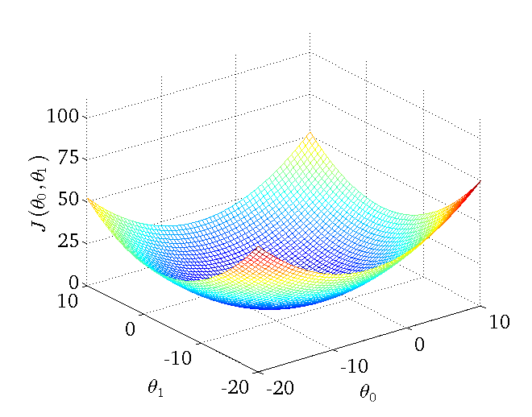
We can see that the height (y) indicates the value of the cost function, so find where y is at a minimum

Slide 36
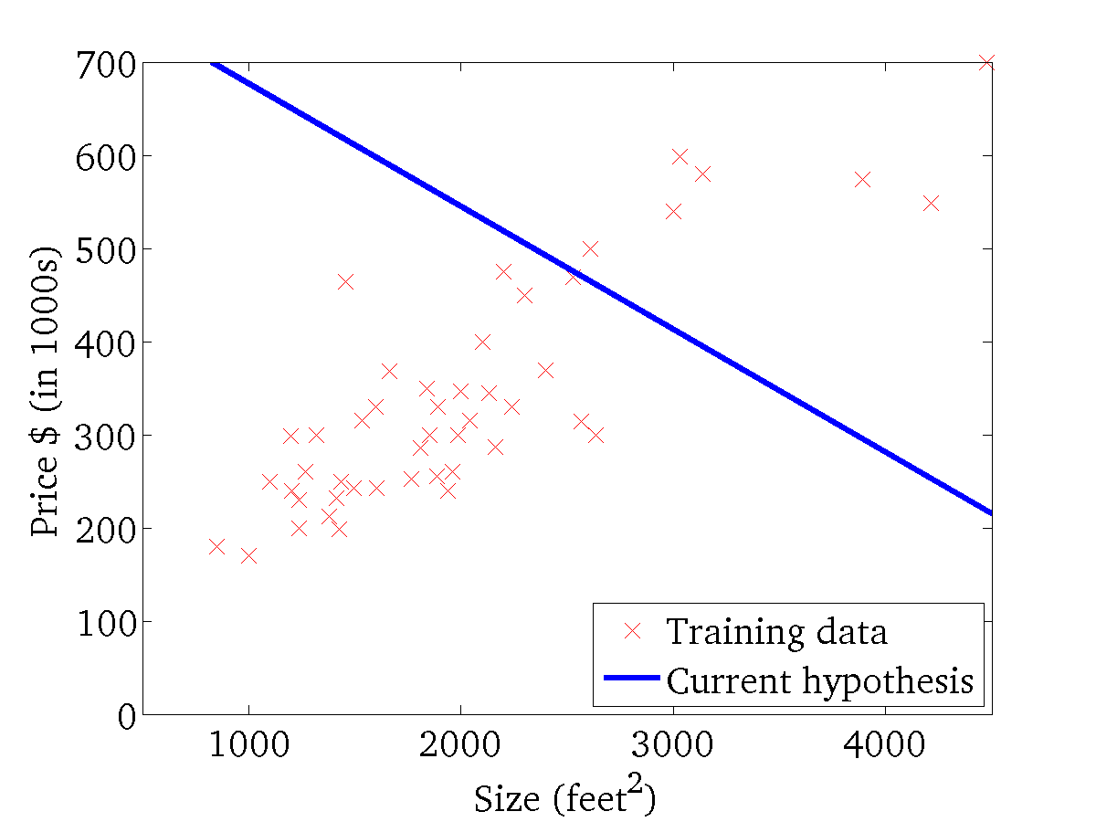
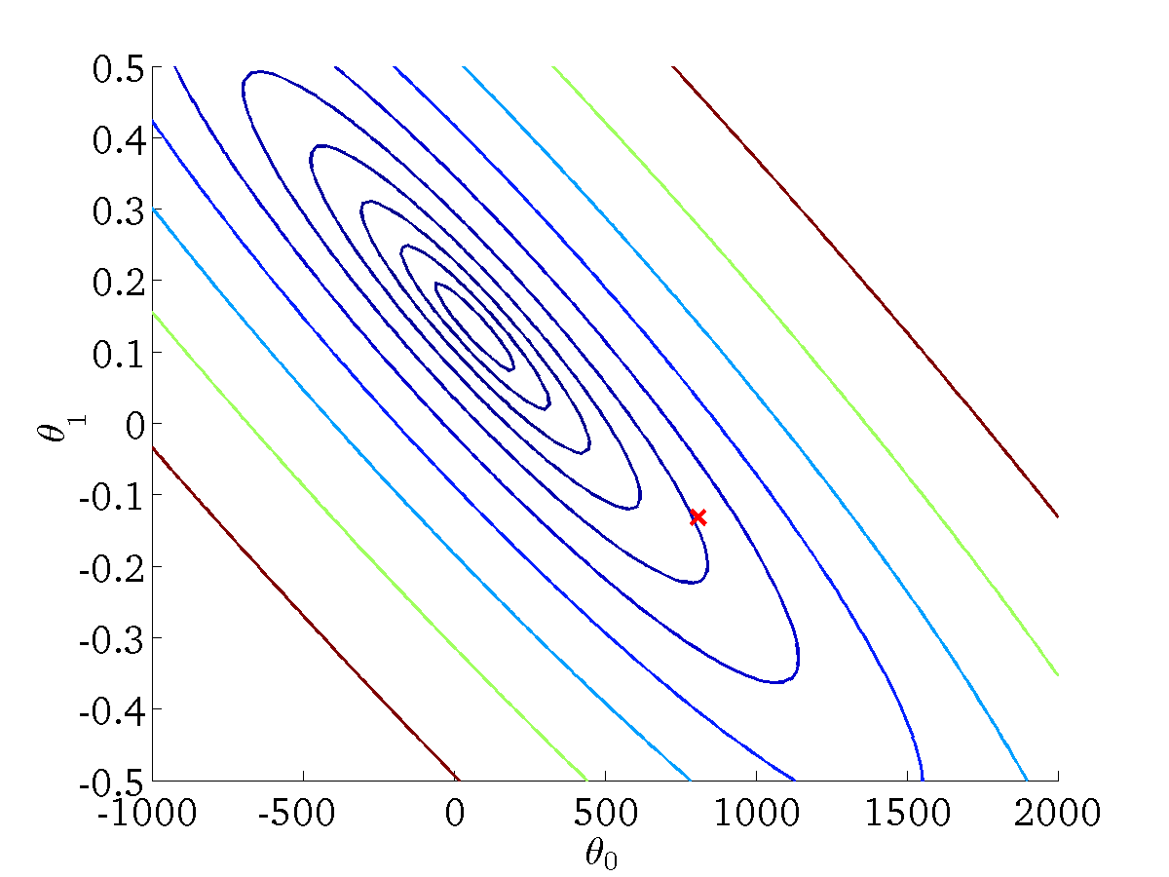
(for fixed , this is a function of x)
(function of the parameters )

Slide 37
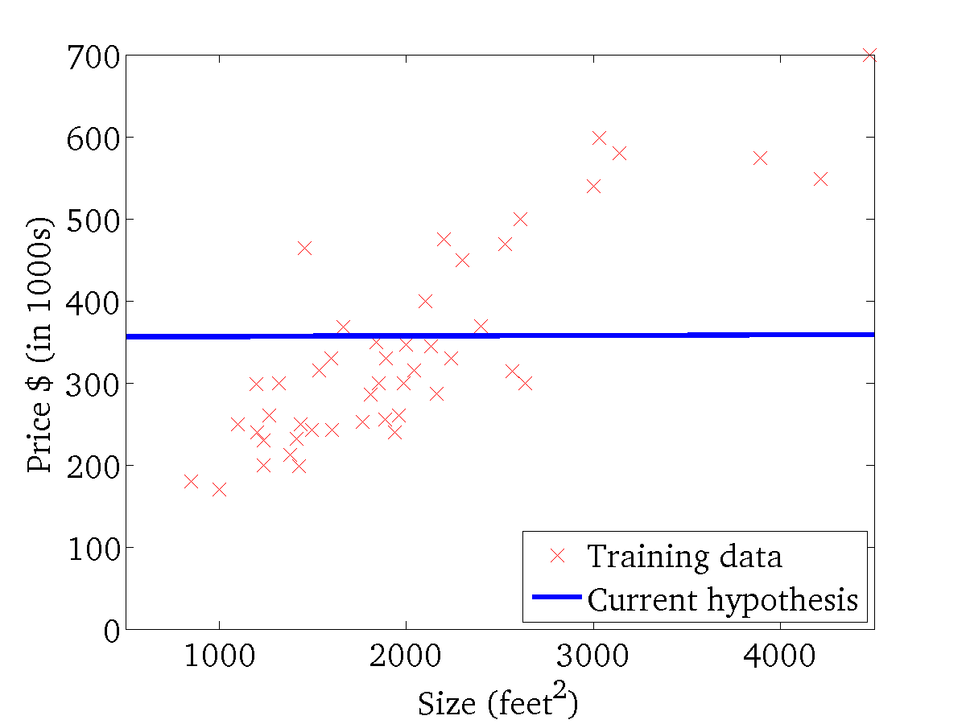
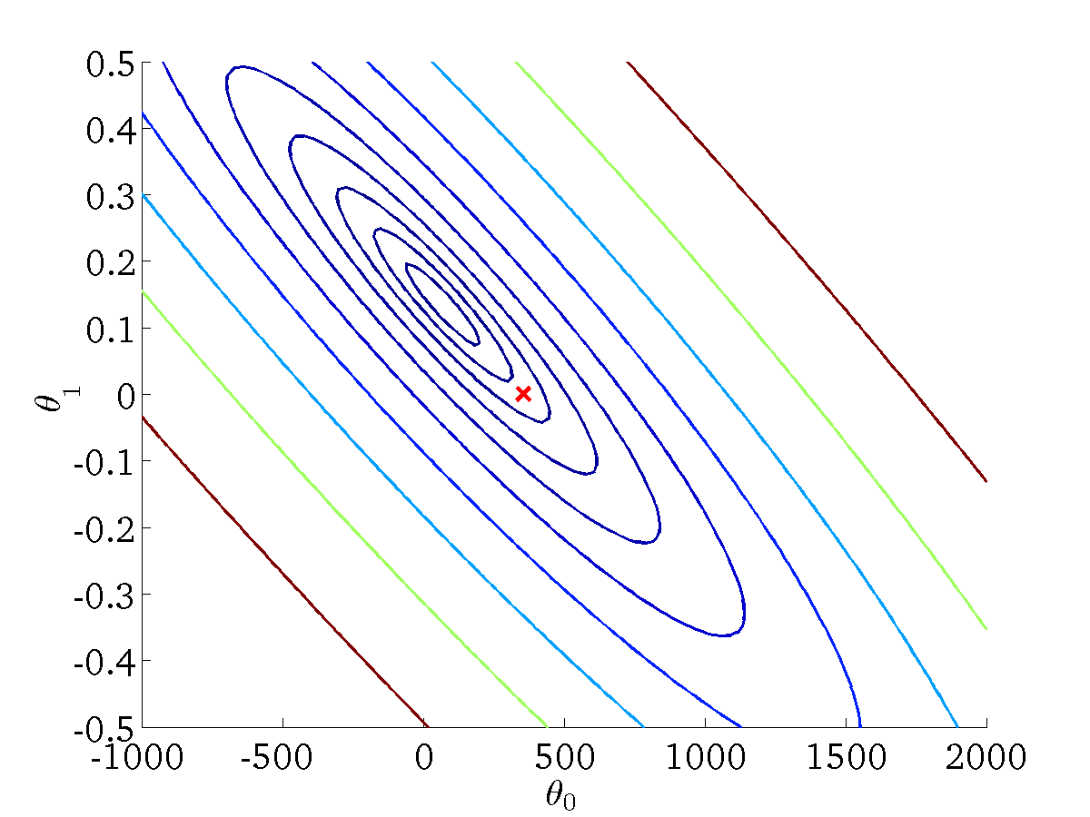
(for fixed , this is a function of x)
(function of the parameters )

Slide 38
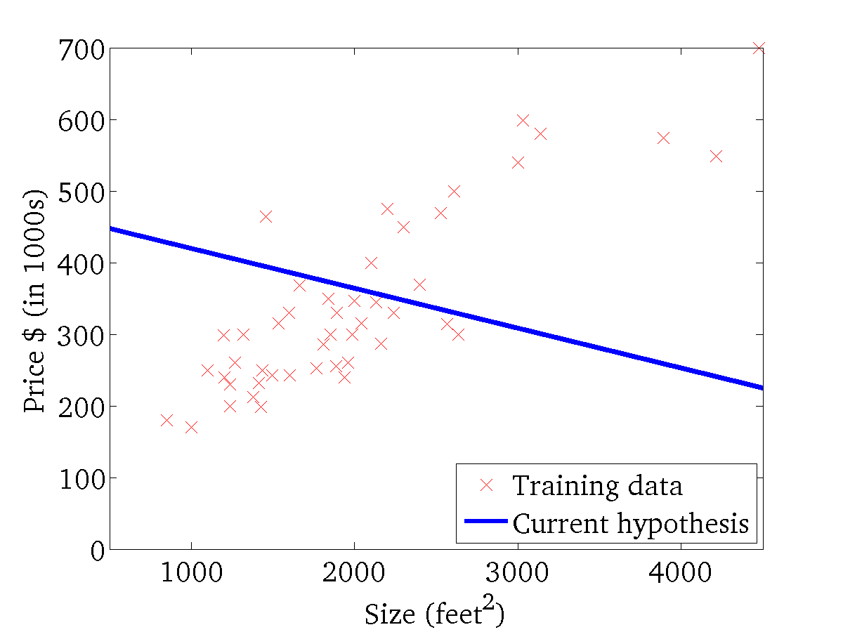

(for fixed , this is a function of x)
(function of the parameters )

Slide 39
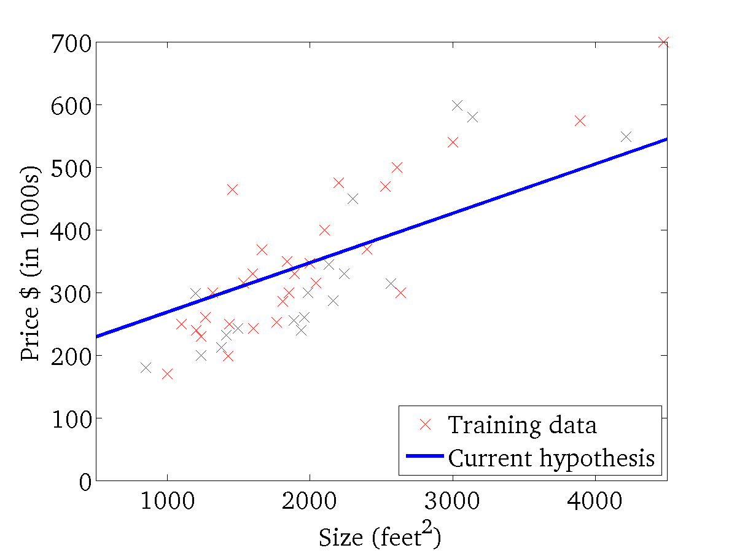
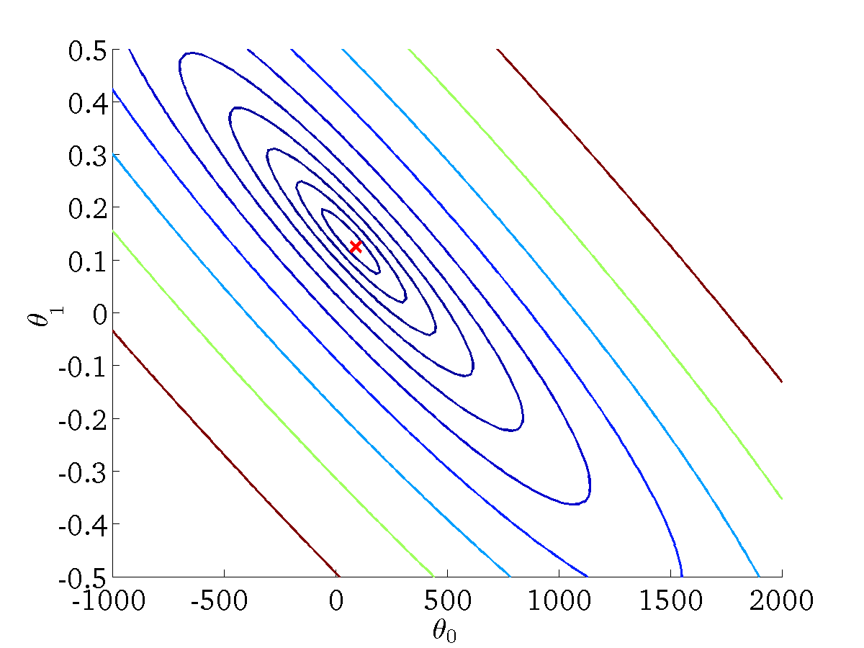
(for fixed , this is a function of x)
(function of the parameters )

Slide 40
Gradient descent
Linear regression with one variable
Machine Learning

Slide 41
Minimize cost function J
Gradient descent
Used all over machine learning for minimization
Start by looking at a general J() function
Problem
We have J(θ₀, θ₁)
We want to get min J(θ₀, θ₁)

Slide 42
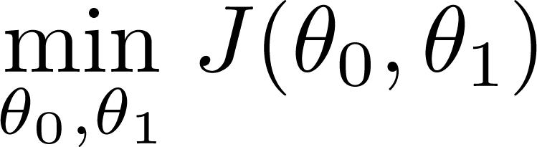
Have some function
Gradient descent applies to more general functions
J(θ₀, θ₁, θ₂ .... θ_{n})
min J(θ₀, θ₁, θ₂ .... θ_{n})
Want
Outline:
Start with some
Keep changing to reduce until we hopefully end up at a minimum

Slide 43
Start with initial guesses
Start at 0,0 (or any other value)
Keeping changing θ₀ and θ₁ a little bit to try and reduce J(θ₀,θ₁)
Each time you change the parameters, you select the gradient which reduces J(θ₀,θ₁) the most possible
Repeat
Do so until you converge to a local minimum
Has an interesting property
Where you start can determine which minimum you end up
Here we can see one initialization point led to one local minimum
The other led to a different one

Slide 44
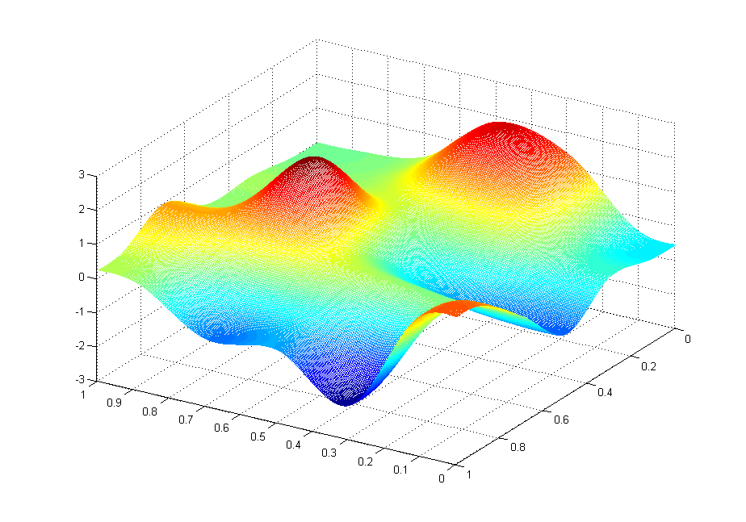
J(θ₀,θ₁)
θ₁
θ₀

Slide 45
J(θ₀,θ₁)
θ₁
θ₀

Slide 46
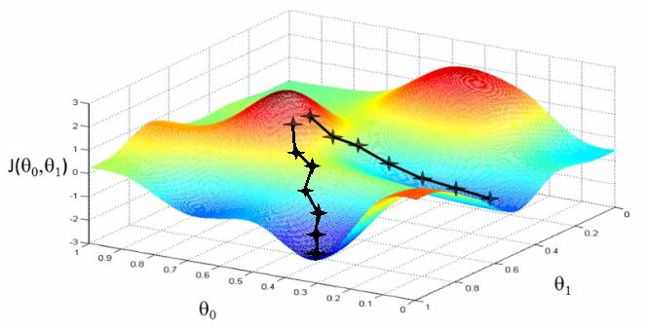

Slide 47
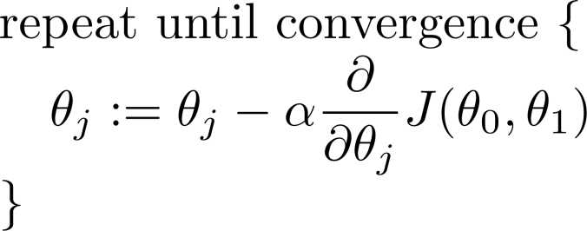
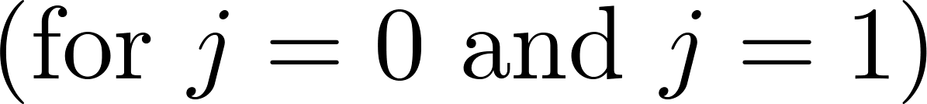
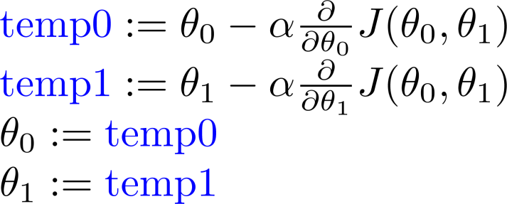
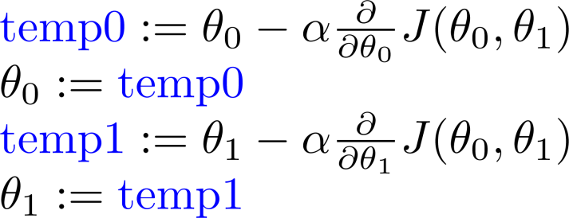
Gradient descent algorithm
Correct: Simultaneous update
Incorrect:

Slide 48
Notation:=
Denotes assignment
NB a = b is a truth assertion
α (alpha)
Is a number called the learning rate
Controls how big a step you take
If α is big have an aggressive gradient descent
If α is small take tiny steps

Slide 49
Gradient descent intuition
Linear regression with one variable
Machine Learning

Slide 50
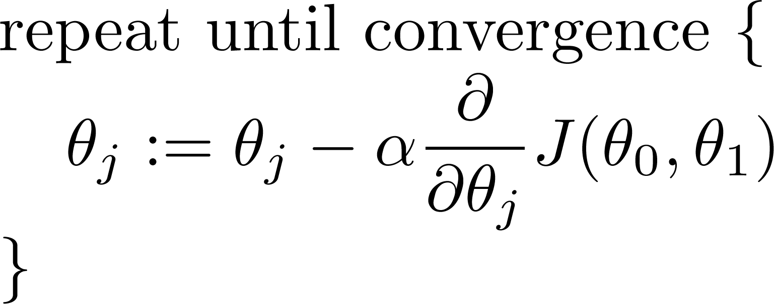
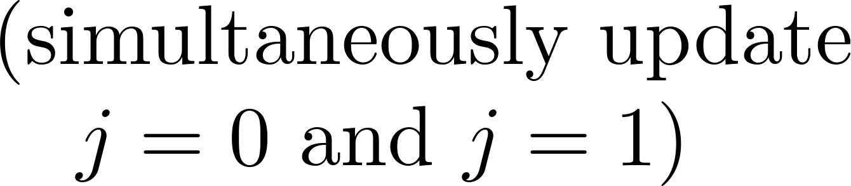
Gradient descent algorithm
To understand gradient descent, we'll return to a simpler function where we minimize one parameter to help explain the algorithm in more detail.
min θ₁ J(θ₁) where θ₁ is a real number

Slide 51
Notation nuances
Partial derivative vs. derivative
Use partial derivative when we have multiple variables but only derive with respect to one
Use derivative when we are deriving with respect to all the variables

Slide 52
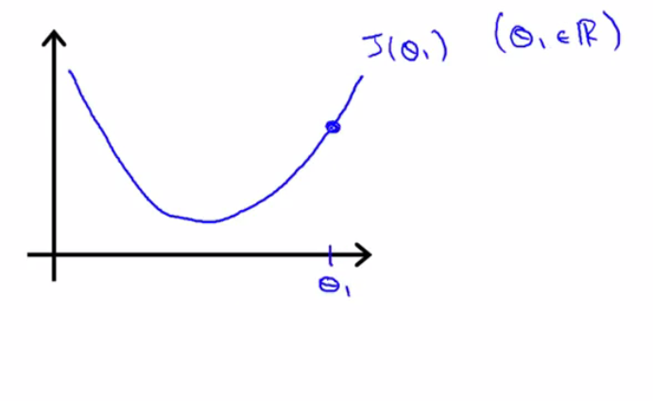

Slide 53
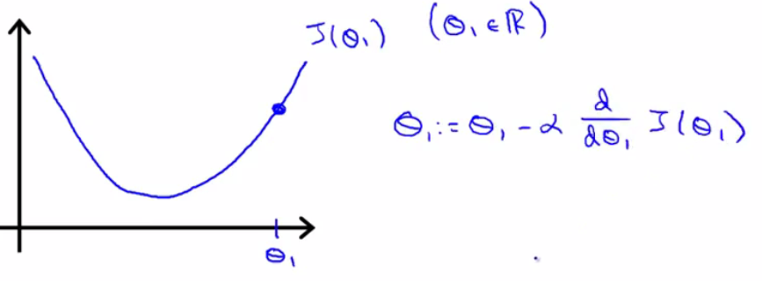

Slide 54
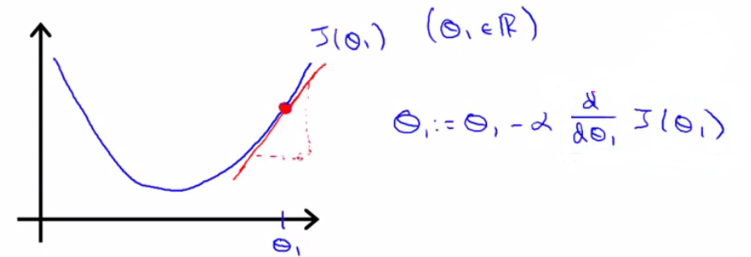

Slide 55
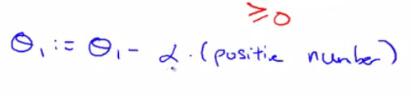

Slide 56
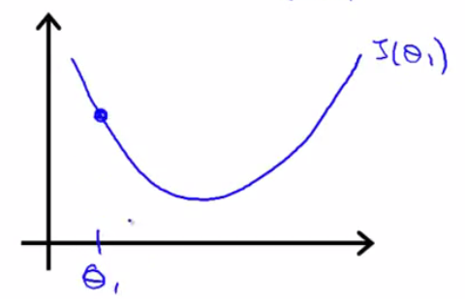

Slide 57
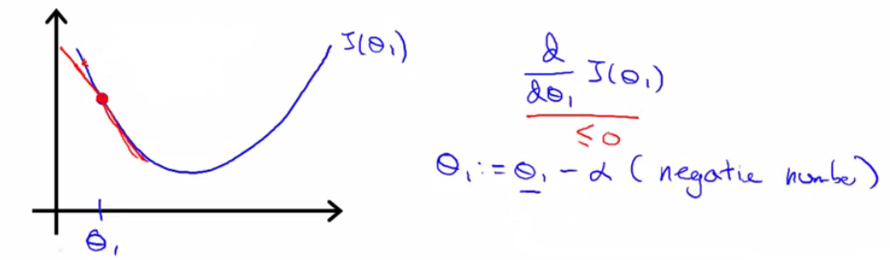

Slide 58
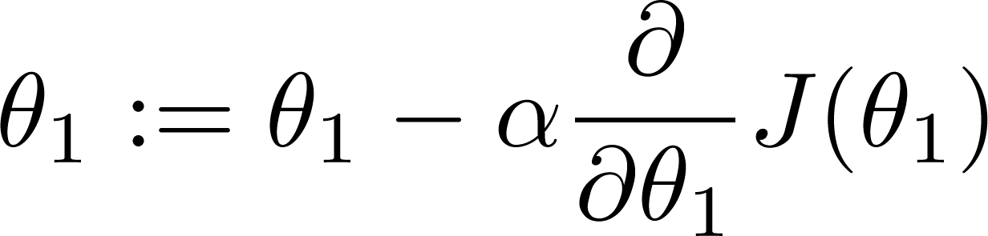
If α is too small, gradient descent can be slow.
If α is too large, gradient descent can overshoot the minimum. It may fail to converge, or even diverge.

Slide 59
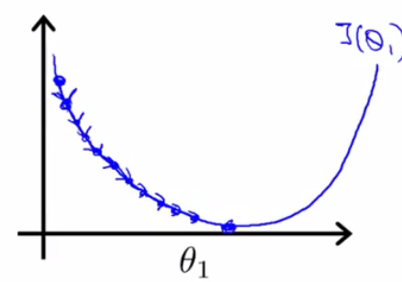
If α is too small, gradient descent can be slow.
If α is too large, gradient descent can overshoot the minimum. It may fail to converge, or even diverge.

Slide 60

If α is too small, gradient descent can be slow.
If α is too large, gradient descent can overshoot the minimum. It may fail to converge, or even diverge.

Slide 61



at local optima
Current value of

Slide 62


Slide 63
Gradient descent can converge to a local minimum, even with the learning rate α fixed.
As we approach a local minimum, gradient descent will automatically take smaller steps. So, no need to decrease α over time.

Slide 64
As you approach the global minimum the derivative term gets smaller, so your update gets smaller, even with alpha is fixed
Means as the algorithm runs you take smaller steps as you approach the minimum
So no need to change alpha over time

Slide 65

Partial Derivative:

Slide 66


